Slide 1

Osprey Design Experience Mid-Semester Presentation

Slide 2

Marc Caina
Tyler Johns
Antonio Mendoza
Christian Ventouras
Nicholas Wedyck
Osprey Senior Design Team
Notes:
Marc

Slide 3
Problem Statement
Single-use PET bottles causes an abundance of pollution
Aim to upcycle bottles and convert them into 3D filament
Automation of at least one step in the Reclamation Process is required
Notes:
Tony

Slide 4
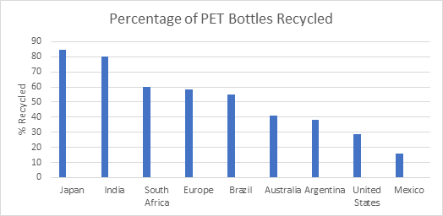
Plastic Waste
Polyethylene terephthalate (PET) is one of the most widely available thermoplastics. It is used in many industries for its tear and tensile strength, food-safe uses, and gas barrier properties. PET plastics have become ubiquitous with food and liquid packaging. Most PET bottles are intended for one-time use and are generally thrown out afterwards. Despite PET bottles being easily recyclable, it still has a low recycling rate.

Slide 5
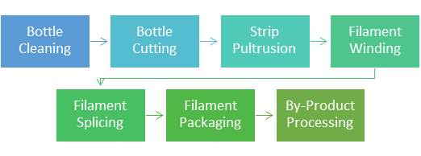
Bottle to Filament Reclamation Process
Notes:
Tony

Slide 6
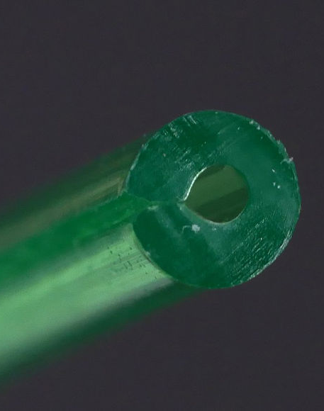
Printing with Reclaimed PET Filament
Extruded at 130% flow rate
Melt temp at 235-245 ℃
Bed temp 65-85 ℃
Part under-cooling causes embrittlement and cloudiness
Part overcooling causes poor layer adhesion
Notes:
Christian

Slide 7
Design Requirements
Reduce duration of reclamation process by 20 percent
Reduce human interaction by 50 percent for the bottle cutting step
Bottle cutting process must accept washed two-liter PET bottles
Must begin the pultrusion strip by cutting a 1.75mm wide ribbon from the bottle
Notes:
Tony

Slide 8
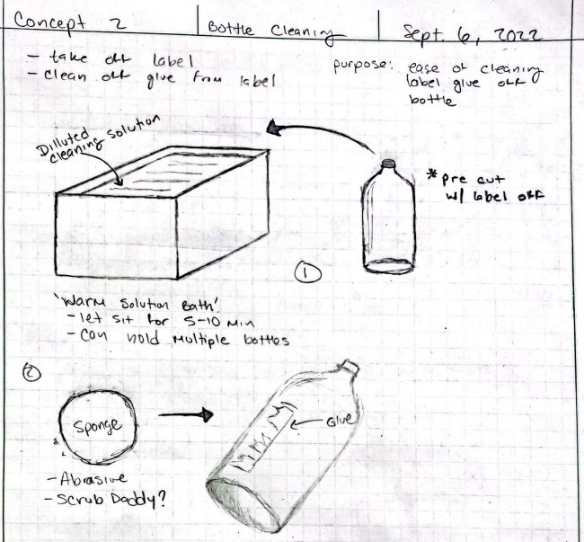
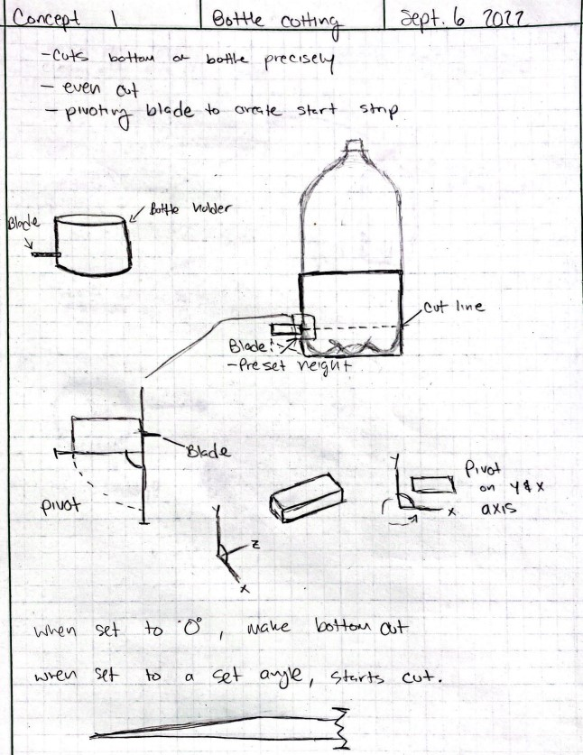
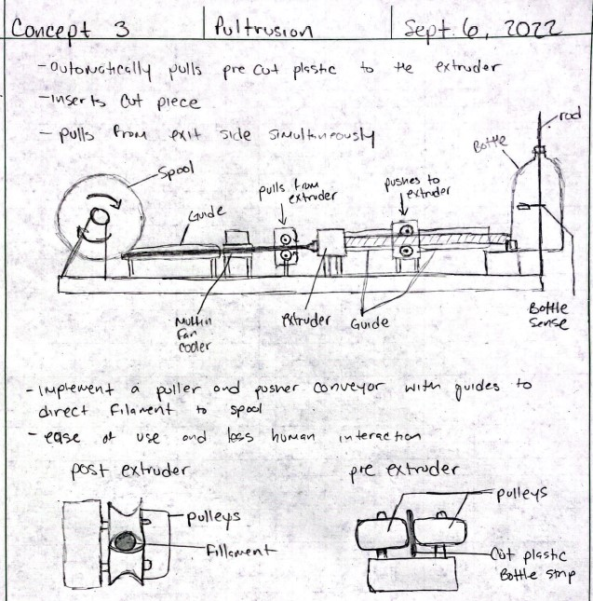
Automation Candidates
Bottle Cleaning
Bottle Cutting
Strip Pultrusion
Notes:
Nick

Slide 9
Design Ideas – Bottle Cutting Idea 1
Similar to Current Design
Bottom Gets Cut
Blade Pivots
Strip Gets Started
Notes:
Nick

Slide 10
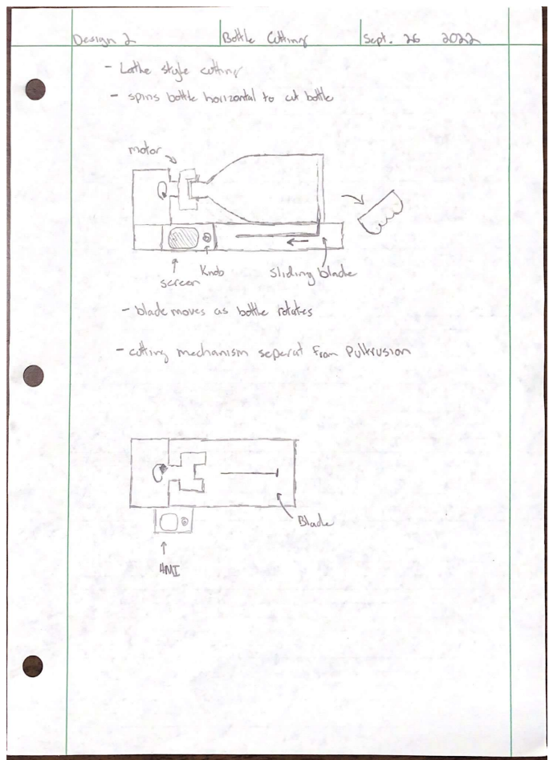
Design Ideas – Bottle Cutting Idea 2
Bottle Placed Horizontally and held by cap fixture
Bottle is rotated to make strips
Initial cut removes the bottom before blade starts moving
Blade moves as bottle rotates until a limit switch is triggered
Notes:
Tyler

Slide 11
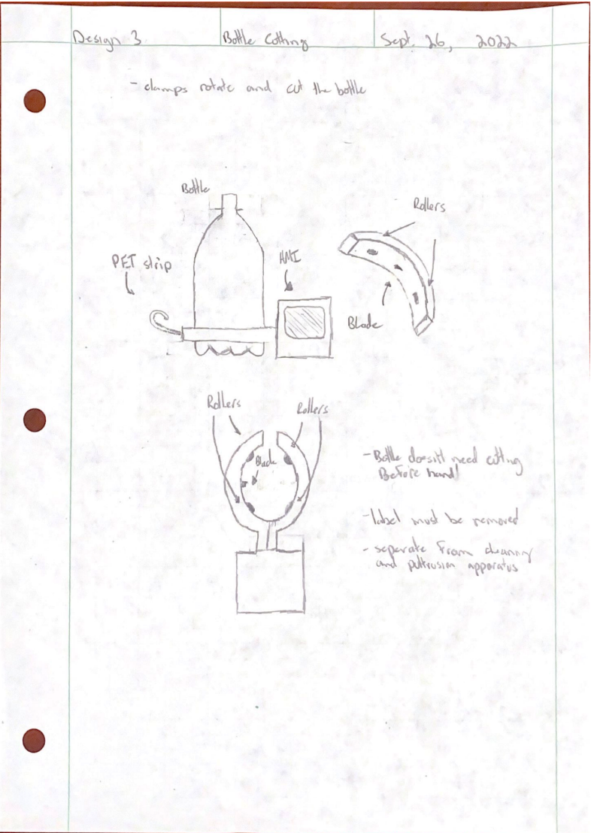
Design Ideas – Bottle Cutting Idea 3
Fixture is separate from cleaning and pultrusion steps
Clamps latch on to bottom of bottle
Rollers spin bottle while blades cut bottom off and start strip cutting
Notes:
Tyler

